Slide 1
holiday

Slide 2
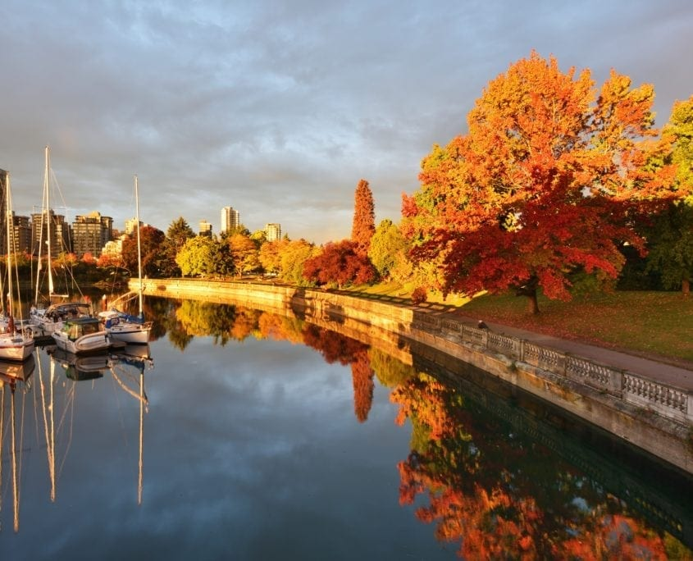
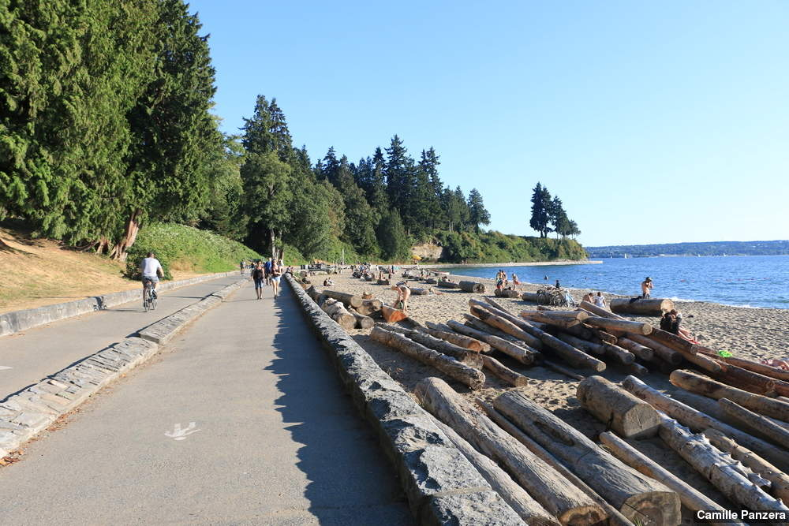
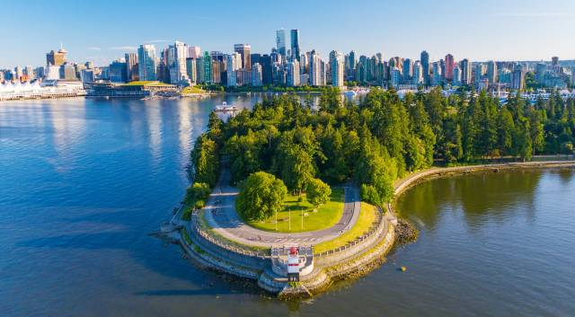
Stanley Park
I’m walking on the trail in this beautiful place called Stanley Park. There are bigger trees than I’ve ever seen. For me, it’s the best experience than I’ve ever had.

Slide 3
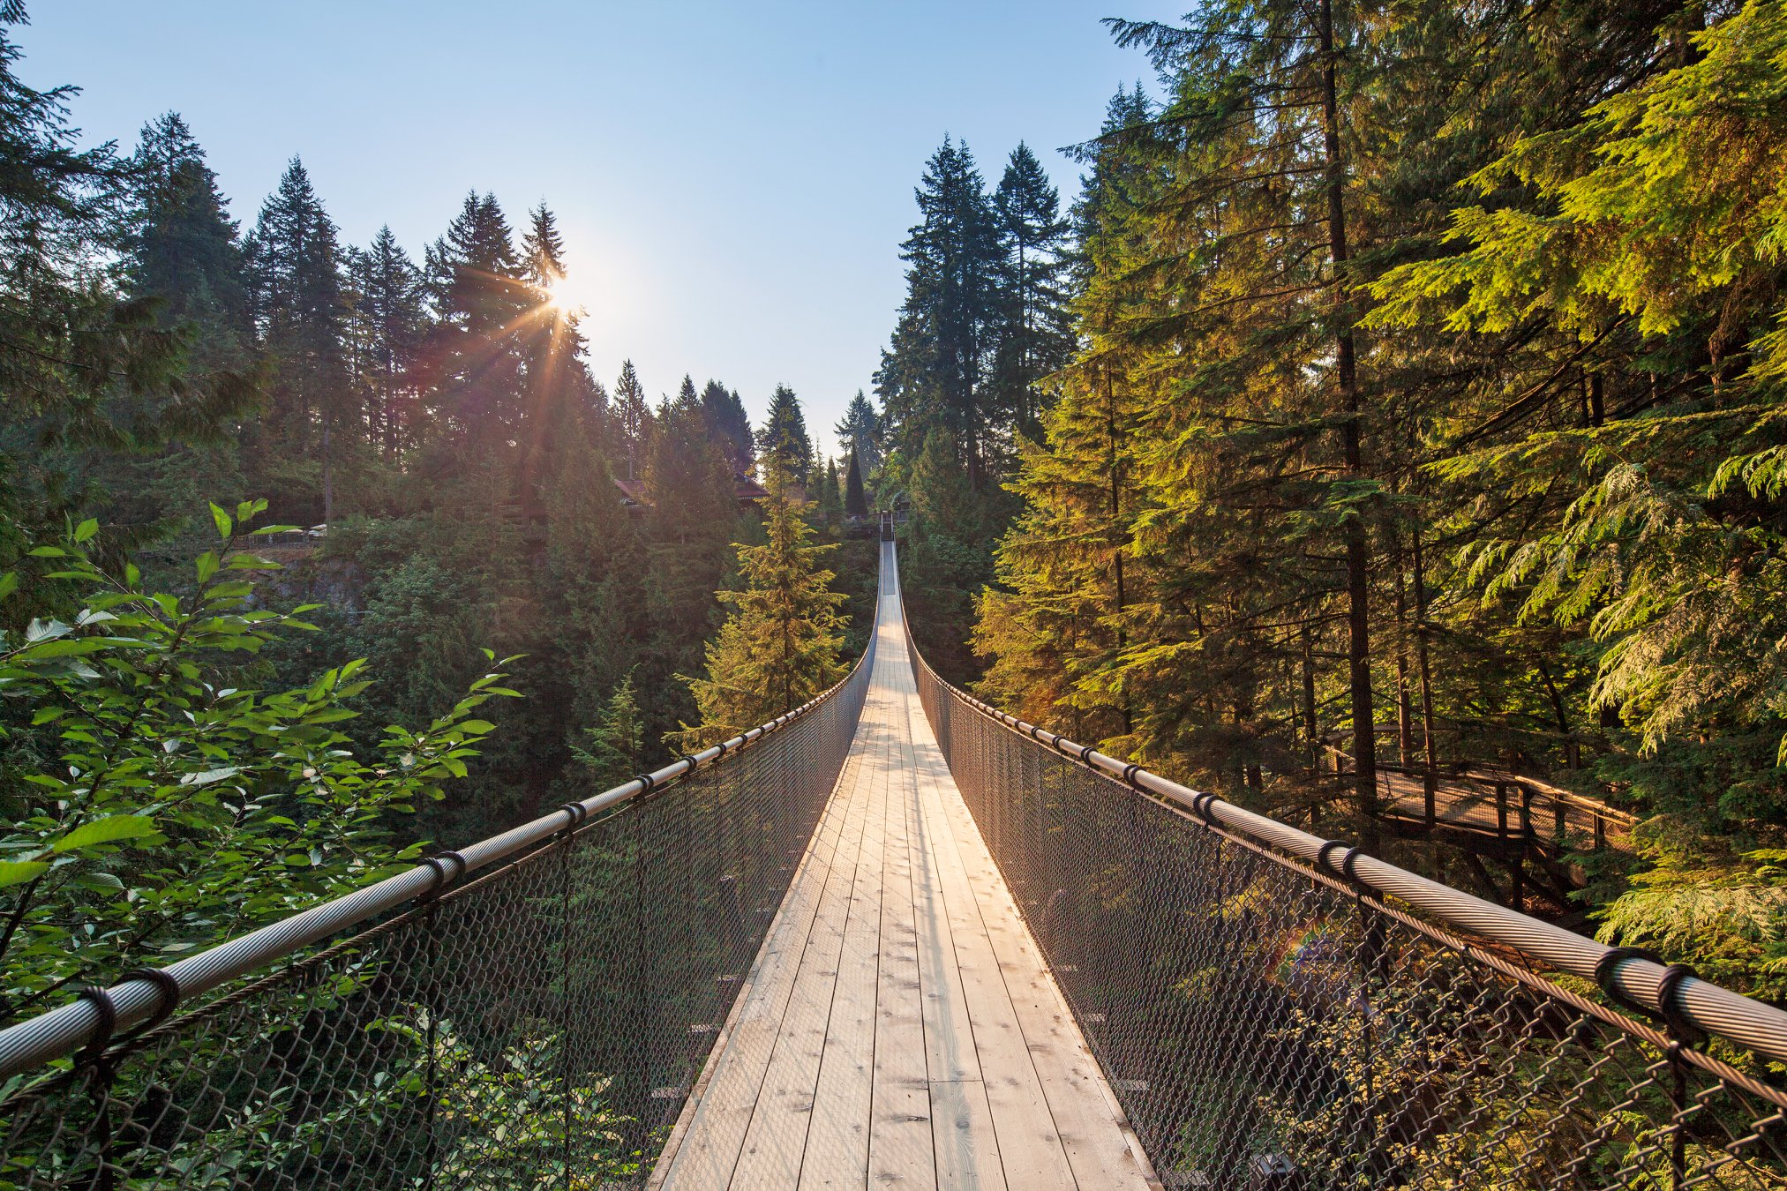
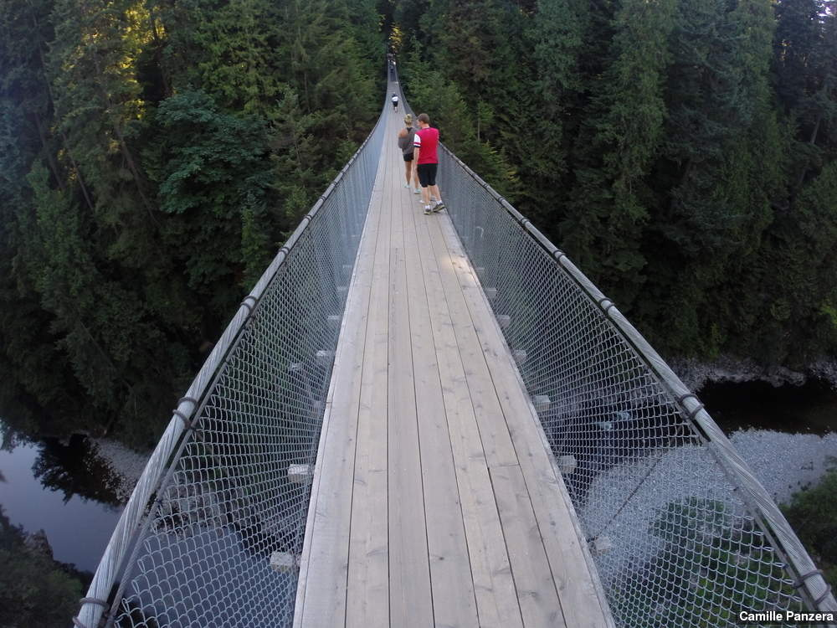
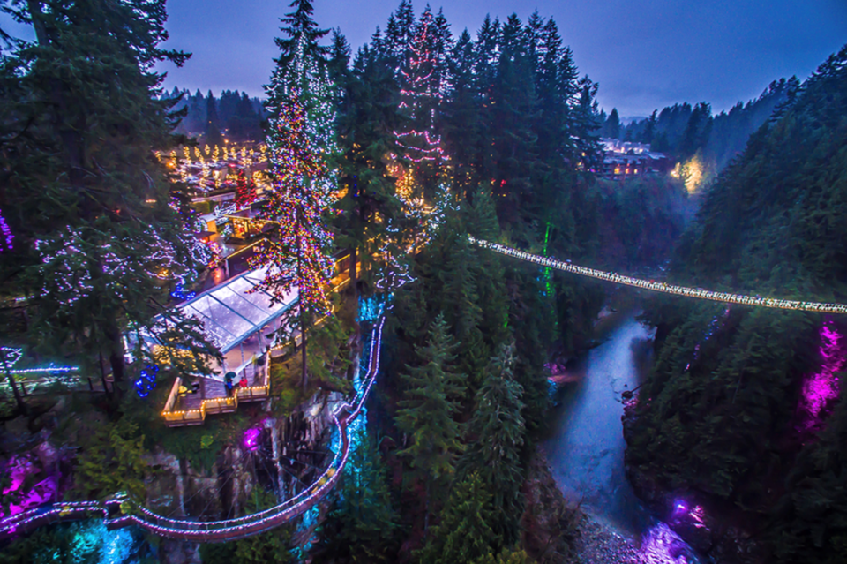
Capilano Suspension Bridge
There are people around me who speaks English and other languages, that’s amazing. We are over a bridge. Honestly speaking I’m a little scared, because this place is so high and there are a lot of people. But, it’s other good experience than I’ve ever had

Slide 4
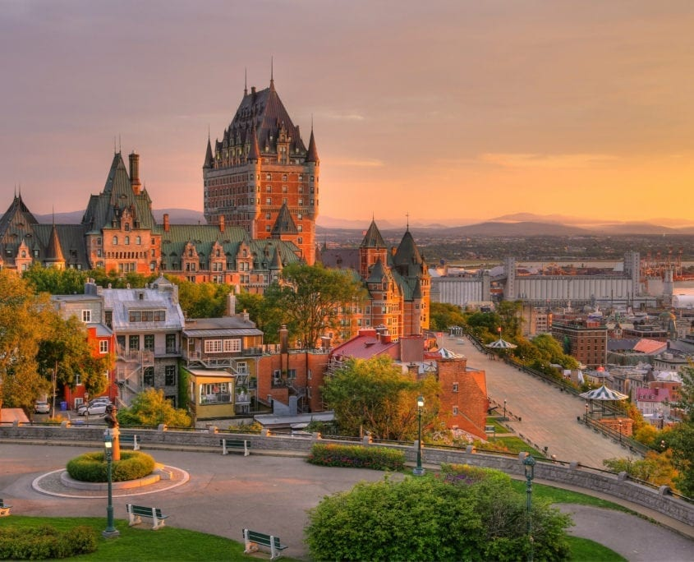
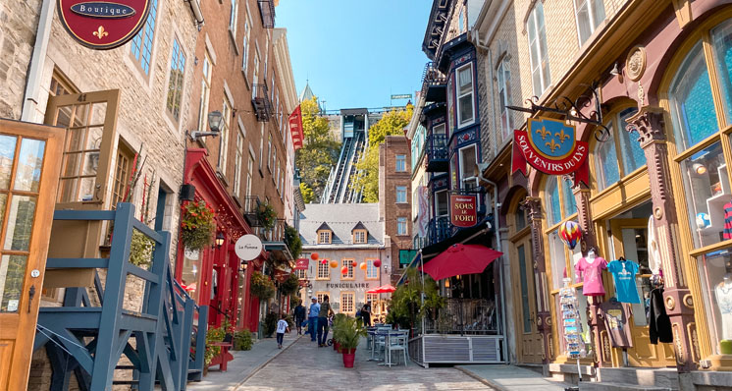
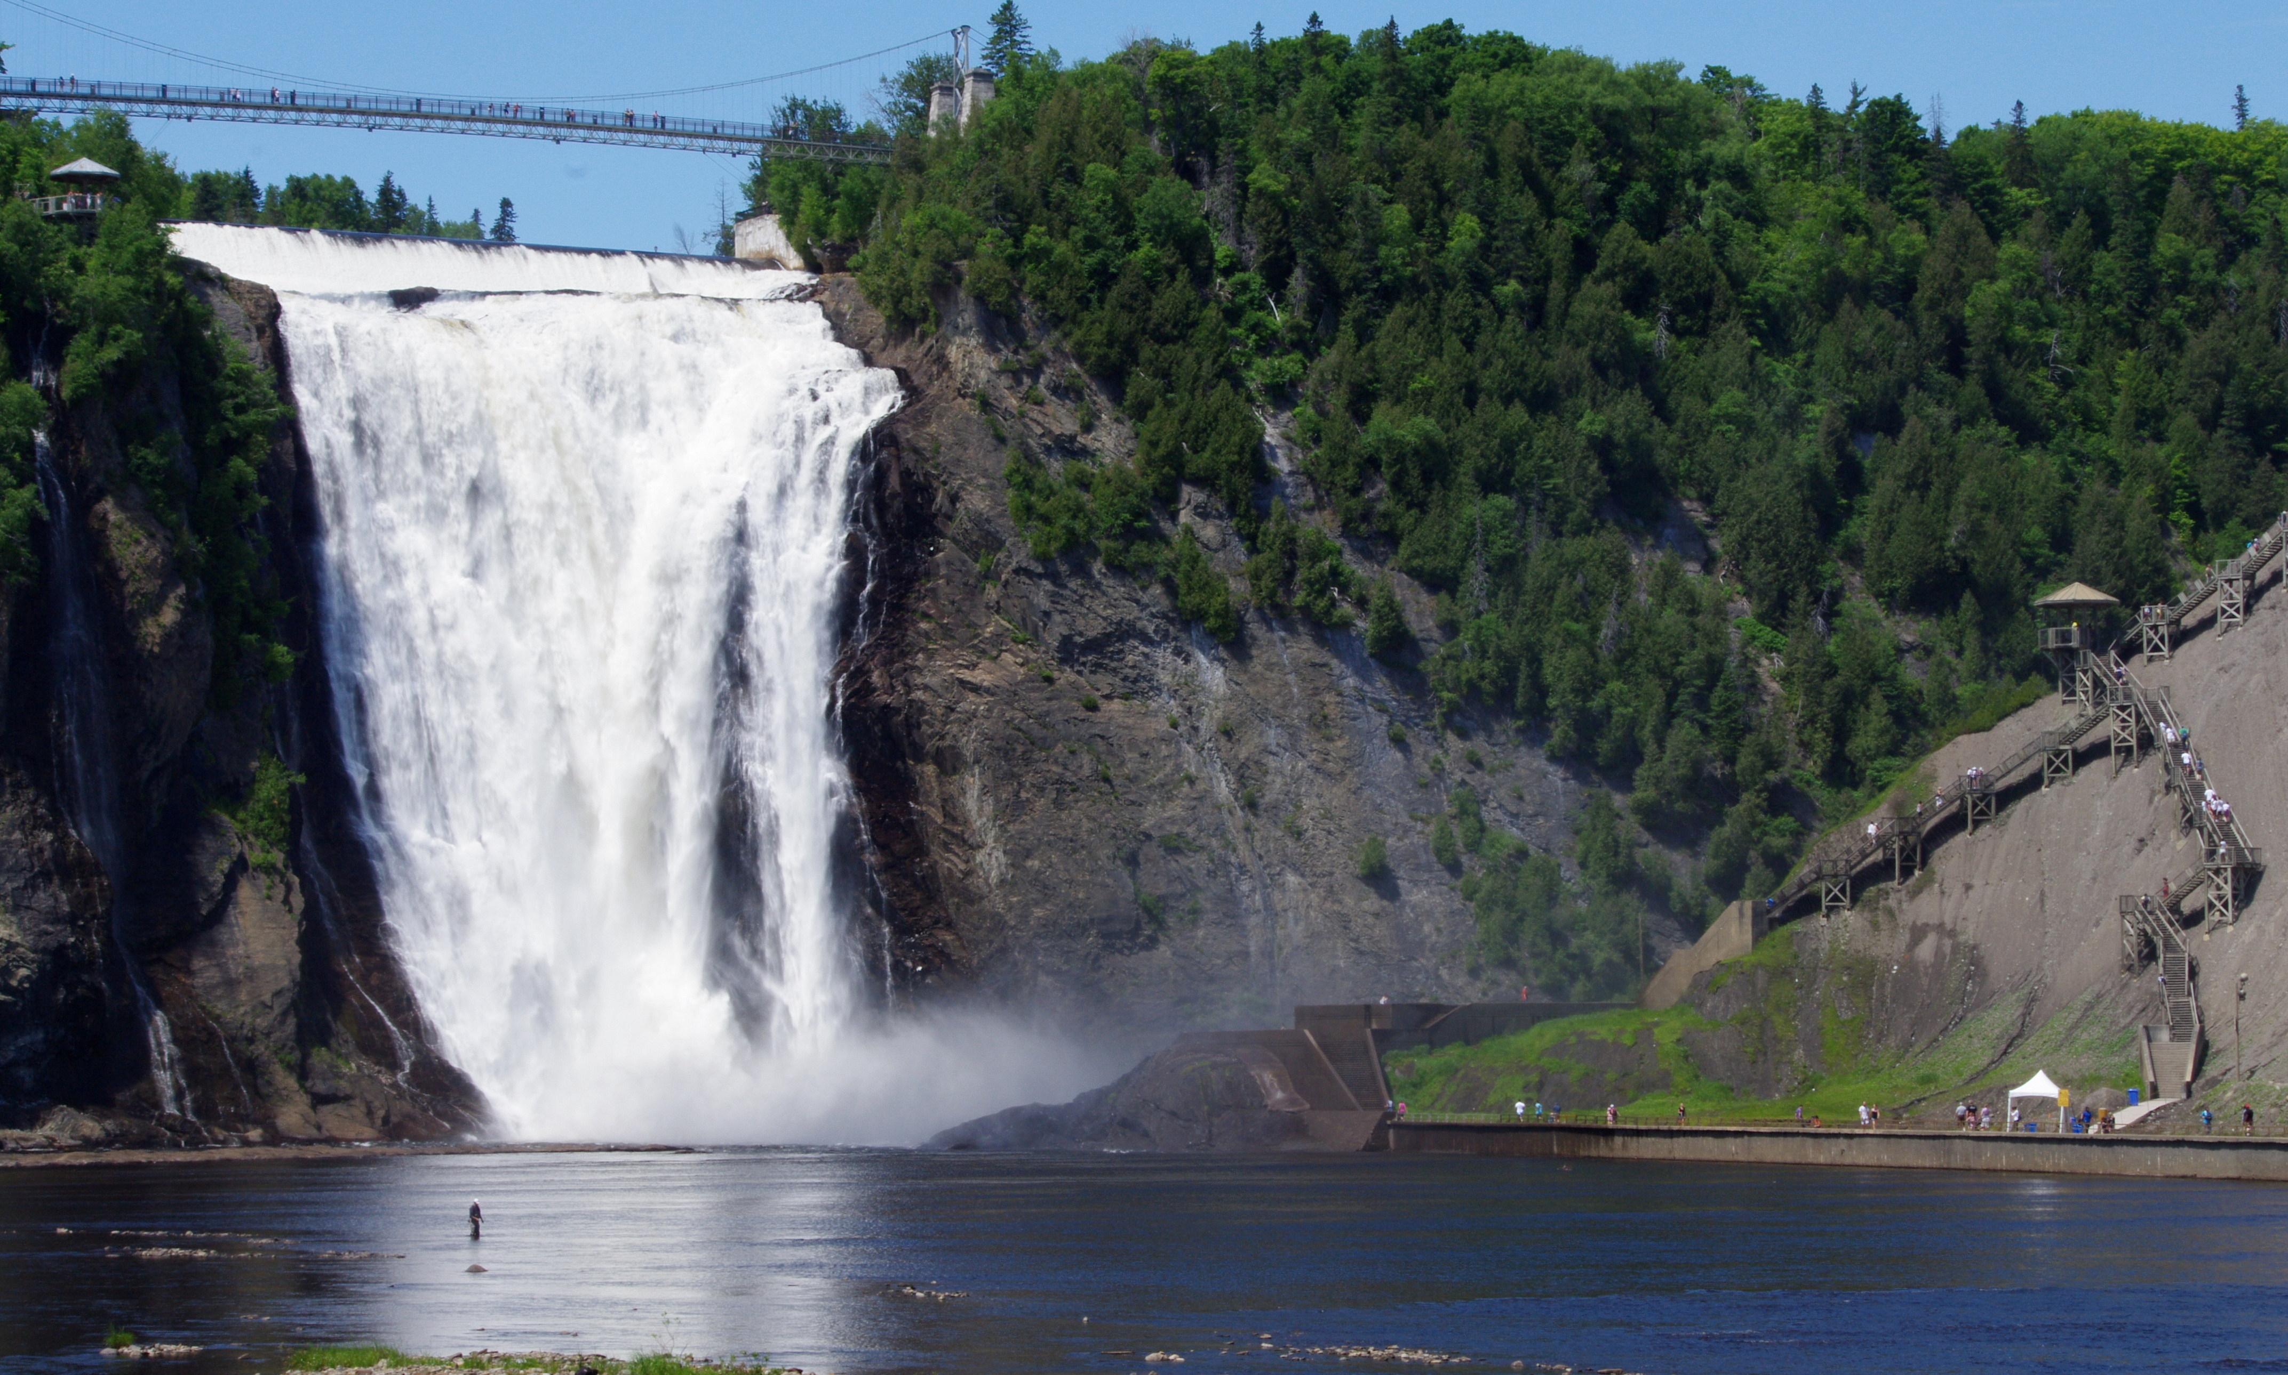
I’m in a beautiful city called Québec City and here are many things to do, like to go to the Place Royale or Chute-Montmorency.

